Slide 1
Python Development Training
WWT / Asynchrony Labs

Slide 2
Introduction
Me
You
Daily Schedule and Content
9:00 to 4:30
Lectures interspersed with examples and labs
ASK QUESTIONS!!!
Notes:
Me: grew up as developer, started Asynchrony, what I used to think was the best way; found XP; found TDD and refactoring; company is now successful doing both every day
* Interested in knowing about their position, language and OO background.

Slide 3
Purpose of the Class
How to write automated tests in Python
How to write tests without calling out to external systems
SCM: Git
How to collaborate in a shared environment
Learn/discuss some best practices when writing Python code
Error handling
Logging
Using REST API
Coding principles
Notes:
What do you want to get out of this class?
Ask questions!!!

Slide 4
Agenda
Day 1
What are automated tests
How to write tests
SCM (Git)
Python Advanced Topics
Day 2
Python Advanced Topics (part 2)
How to write tests with external systems
Larger lab
Notes:
What do you want to get out of this class?
Ask questions!!!

Slide 5
Automated Tests Overview

Slide 6

Why Tests?
When the code base is shared, testing ensures you’re not breaking somebody else’s code
Testing means you know the code works the first time (translates to $$$ saved)
Automation makes testing repeatable
$$$$$$$$$$$$
Notes:
Instructors Note: This is a class discussion
Creates space for thinking while coding
Promotes a “learning” style of programming
Try it, learn from it, use that learning
Inspires confidence in your code
Design emerges from use.
Tests DRIVE your development process
Tests help design the ‘flow’ and feel of your API.
They are written from the perspective of the class your testing.
Has the side effect of improving the design of the interface!
Tests are Executable documentation!

Slide 7
Test Driven Development
What is TDD?
Red, Green, Refactor
Only write production code once there is a failing test
Only write as much code as needed to make the test pass
Is it worth it?
Notes:
Sum up Agile in your own words
Feedback loops -> TDD allows us to respond to change

Slide 8
Tools of Testing for Python
Automated, self-checking tests
Python testing frameworks
pyunit / unittest
pytest
CI/CD Pipelines
Jenkins
Gitlab

Slide 9
Assertions in Python
An assertion is a sanity-check that you can turn on or turn off when you are done with your testing of the program.
The easiest way to think of an assertion is to liken it to a raise-if statement (or to be more accurate, a raise-if-not statement). An expression is tested, and if the result comes up false, an exception is raised.
Programmers often place assertions at the start of a function to check for valid input, and after a function call to check for valid output.

Slide 10
Assertions in Python, Continued......
When it encounters an assert statement, Python evaluates the accompanying expression, which is hopefully true. If the expression is false, Python raises an AssertionError exception.
The syntax for assert is:
def test_something():
assert 1 == 2, "These numbers are not the same!"
If the assertion fails, Python uses ArgumentExpression as the argument for the AssertionError.
AssertionError exceptions can be caught and handled like any other exception using the try-except statement, but if not handled, they will terminate the program and produce a traceback.

Slide 11
Create a simple test
Act of design
Client’s point of view
Arrange/Act/Assert
Arrange: Arrange all necessary preconditions.
Act: perform the action under test
Assert: assert the expectations
def test_calculator_add():
calc = Calculator() # arrange
result = calc.add(1, 1) # act
assert result == 2 # assert

Slide 12
Create a simple test (cont.)
Create class, run test. Let the test fail (Red)
Add the smallest amount to make it pass(Green)
class Calculator:
def add(self, first, second):
return 0
class Calculator:
def add(self, first, second):
return 2
Notes:
Just enough code to compile – but fails test
Just enough code to pass test

Slide 13
Design Improvement
Refactor:
Change form of code but not functionality
Remove duplication, literals, etc.
Notes:
This is called refactoring.
Magic values === bad

Slide 14
Group Lab: Ice Creamery
Order an ice cream by choosing size and toppings
Ex: 2 scoops, vanilla
Returns the price:
Pricing:
1 scoop = $3, 2 scoops = $4, 3 scoops = $5
Each added topping is $0.50
Toppings: sprinkles, hot fudge, carmel, chocolate chips
IceCreamParlor().order(2, [Topping.HOT_FUDGE, Topping.SPRINKLES])
print(IceCreamParlor().order(…))
>> "$5.00”

Slide 15
Student Lab: Pizzeria
Order a pizza by choosing size and toppings
Ex: small, pepperoni
Returns the price:
Pricing:
small = $10, medium = $15, large = $20
Each non-meat topping = $1
Meat topping = $2
Pizzeria().order(Size.SMALL, [Topping.PEPPERONI])
print(Pizzeria().order(…))
>> "$12.00"

Slide 16
Lab Retro
What did you learn?
What did you like/dislike?
Notes:
Now that we’ve seen it and tried it a bit, let’s talk about what we did, and what we could do next time…

Slide 17
Testing Best Practices
When do we run our tests?
Test first?
As we write our code
On code check-in
As often as we can
Tests should run fast
Thousands in seconds
Where do tests run?
Ultimately not on the machine they were written on
CI/CD pipeline
GitLab/Jenkins/TravisCI/etc
Notes:
Antipattern – GuruChecksOutput – mention humorous and horrifying story (see Mark Balbes)

Slide 18
Source code Management
Fundamentals of GIT

Slide 19
Group Lab: git_basics
Add files
Status
Committing files
Update files
Log
Branching
Merging/Rebasing
Conflicts
Workspace vs Remotes
Tagging

Slide 20
Git Overview
Created by Linus Torvals, in 2005, in order to have a better way to manage the source for the Linux kernel.
A distributed source control system
Everyone has a full copy of the entire history of the repo.
History stored as a series of snapshots.
Remote repos used to collaborate (ie. Github).
A branches and tags are cheap, they’re just a pointer to a commit.
master is just another branch.

Slide 21
Git Configuration
~/.gitconfig
./.git/config
.gitignore
# ~/.gitconfig
[user]
name = Matt Todd
email = matt.todd@asynchrony.com
[Alias]
ci = commit
co = checkout
st = status -sb
br = branch
# .gitignore
.DS_Store
*.pyc
__pycache__

Slide 22
Collaboration Models
Dictator (common among small open-source projects)
Single person (or very small group) able to commit to the releasable branch.
Collaborators contribute via Pull Requests (PR).
Dictator and Lieutenants (common among large open-source projects)
Single person (or very small group) able to commit to the releasable branch
Lieutenants responsible for sub-sections. Submits PRs to Dictator for their sub-section.
Collaborators contribute via PRs to the Lieutenants responsible for the appropriate sub-section.

Slide 23
Collaboration Models
All Equal (common among private or internal projects)
Everyone has the same access.
Commit coordination done via outside communication channels.

Slide 24
Branching Strategies
Dirty Dev
Environment branches
Git Flow

Slide 25
Git Flow

Slide 26
Clone a Repo
Copy’s the source into a new directory in your current location.
Sets your local repo’s origin to the ’cloned from’ location.
$ git clone [url]
$ git clone https://github.com/geekcomputers/Python.git

Slide 27
Working with Branches
View local branches.
Create a new branch from the current branch.
Remove local branches by name.
$ git branch # displays a list of all local branches
$ git branch bananas # creates branch named bananas
$ git branch –d bananas # deletes branch named bananas

Slide 28
Changing Branches
Before switching branches, your current branch must be free of uncommitted changes.
Can checkout to a specific commit sha.
$ git checkout [branchName or commitSha]
$ git checkout bananas
$ git checkout –b bananas # shortcut to create a new branch \
and checkout that branch

Slide 29
What’s My Status?
The status command shows you your active branch, changed files, and tracked and untracked files.
$ git status

Slide 30
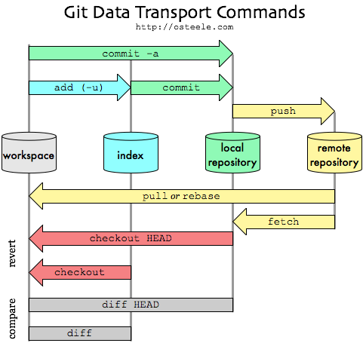
Staying Up-To-Date
Fetch
Merge
Pull
$ git fetch origin
$ git merge origin/bananas
--- or ---
$ git pull bananas
Notes:
Git fetch retrieves changes from all remote repositories unless a remote is specified
Git merge will combine the local repository with the index/workspace
Git pull does a fetch and merge operation as one

Slide 31
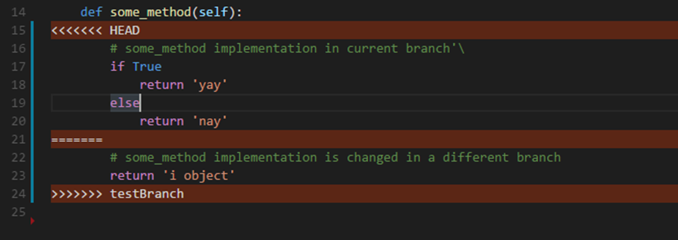
Dealing with Conflicts
Fixing the conflict in the code.
Notes:
An example of what a merge conflict looks like in the code AFTER a merge operation is executed.
Head is our current branch changes

Slide 32
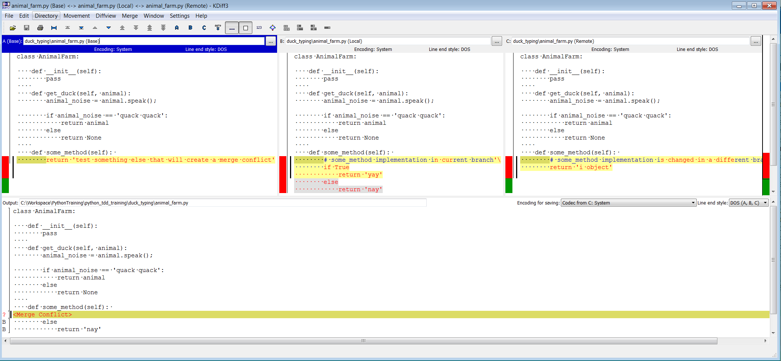
Dealing with Conflicts (cont.)
Fixing the conflict with a merging tool.
Notes:
Base is the remote to the current branch
Local is our current branch with our recent changes
Remote is the branch we are trying to merge that has changes to the same line of code that we changed

Slide 33
Undoing Changes
How much do you want to undo?
$ git checkout <filename>
$ git reset -–hard
$ git clean
$ git revert <sha5>
Notes:
Git checkout filename is the least invasive undo operation. It only touches the file supplied to the command
Git reset –hard resets the entire branch to the head of the repository
Git clean removes any untracked files from the repository
Git revert will remove the changes in a given commit and create a new commit with the removed changes.

Slide 34
Pushing Changes
For a newly created branch you will need to set the up-stream to the remote repository branch.
$ git push
$ git push origin/bananas
$ git push different/bananas
$ git push –set-upstream origin bananas
--- or ---
$ git push –u origin bananas
Notes:
Git push assumes the upstream is already set (to origin)
Git push <remote> specifies explicitly where the changes should be sent.
Origin/ is the default remote which can be changed
-u is syntactic sugar for --set–upstream which is required when pushing to a new remote

Slide 35
Git UIs
Visual tools: see relationships between branches, easily change the status of files in the repository, perform all functions without having to know command line syntax
Gitk* – comes out of the box, good for quick visualization
SourceTree* – used by some teams at WWT
GitHub Desktop
Built into IDEs
Atom
VisualStudio
Android Studio
XCode
Beyond Compare (diff tool)
Many more…
* Tends to be more popular at WWT/AL
Notes:
Using a GUI is a religious debate, some like them some don’t. It is better to know the command line to be sure you can perform the necessary operations without a GUI.
However, GUI’s do simplify some issues such as resolving difficult merge conflicts, managing multiple repositories and visualizing the branching.
Don’t be dependent on a GUI!!

Slide 36
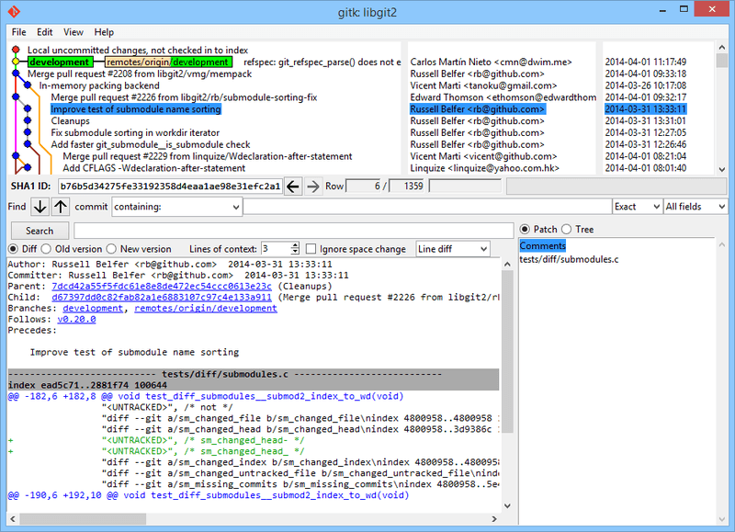
Gitk
Simple
Comes with Git installation
$ gitk
Notes:
Invoke this gui with the “gitk” command.
Visualizer of origins/branches/commits

Slide 37
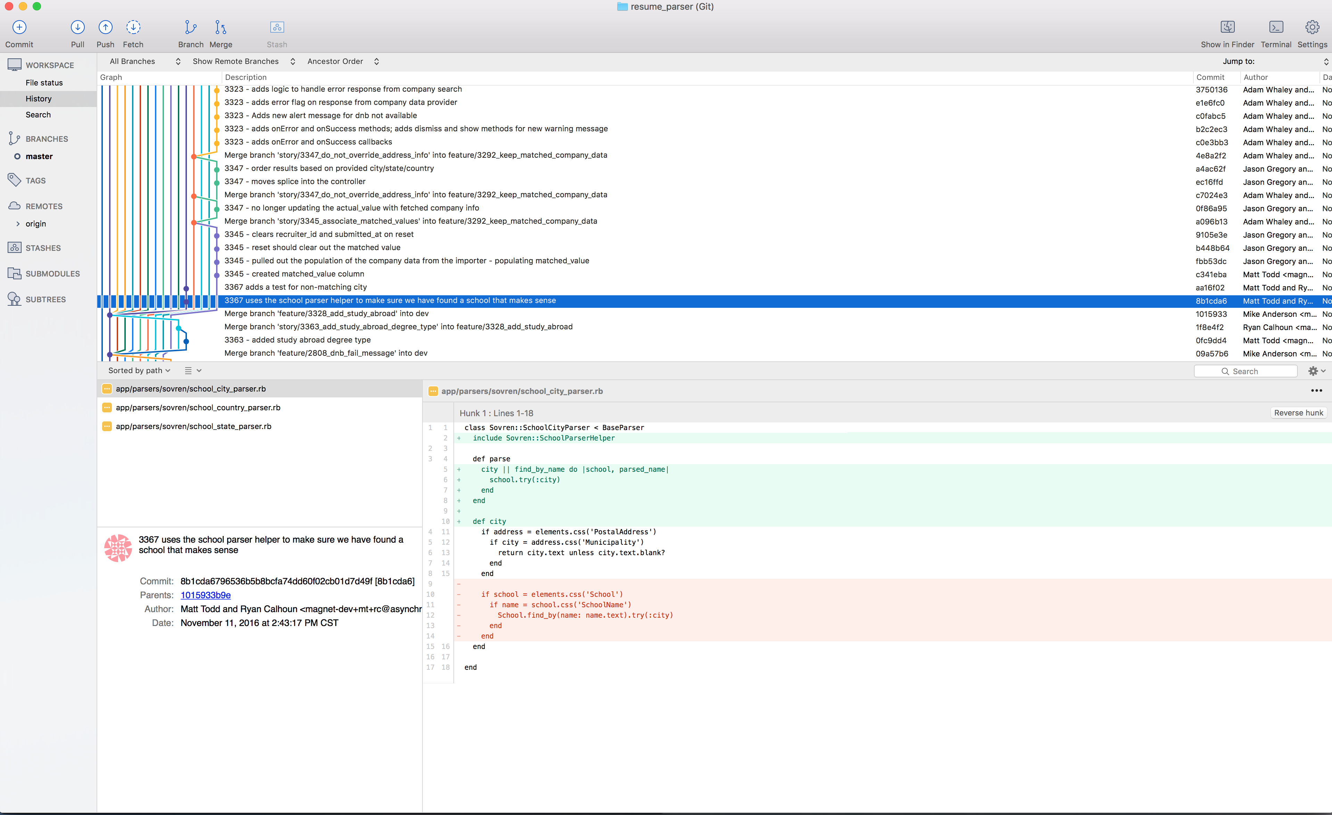
SourceTree
Preferred by many developers at WWT and ASL
Runs on either Mac or Windows, although most think the Mac version is better
Has GitFlow built in

Slide 38
SCM Best Practices
Avoid long running branches
Use lower case for branch names, files and folders to avoid confusion between case sensitive and insensitive environments
Branches names with only number could be confused with a git SHA
Make small, frequent commits
Merge master into development branch often (1x/day) to avoid merge conflicts
Test before merging
Don’t push a broken build
Write informative commit messages

Slide 39
Student Lab: Dossier
Clone project
Create a new branch
Make changes
Push them up
Merge someone else’s branch

Slide 40
Working with Pull Requests
Source Control Fundamentals

Slide 41
What is a Pull Request For?
Maintains code integrity
Allows for reviewing the code before acceptance
A natural process for code reviewing
Provides governance over what’s included in the final product
Notifies the project management team that there is new code for review

Slide 42
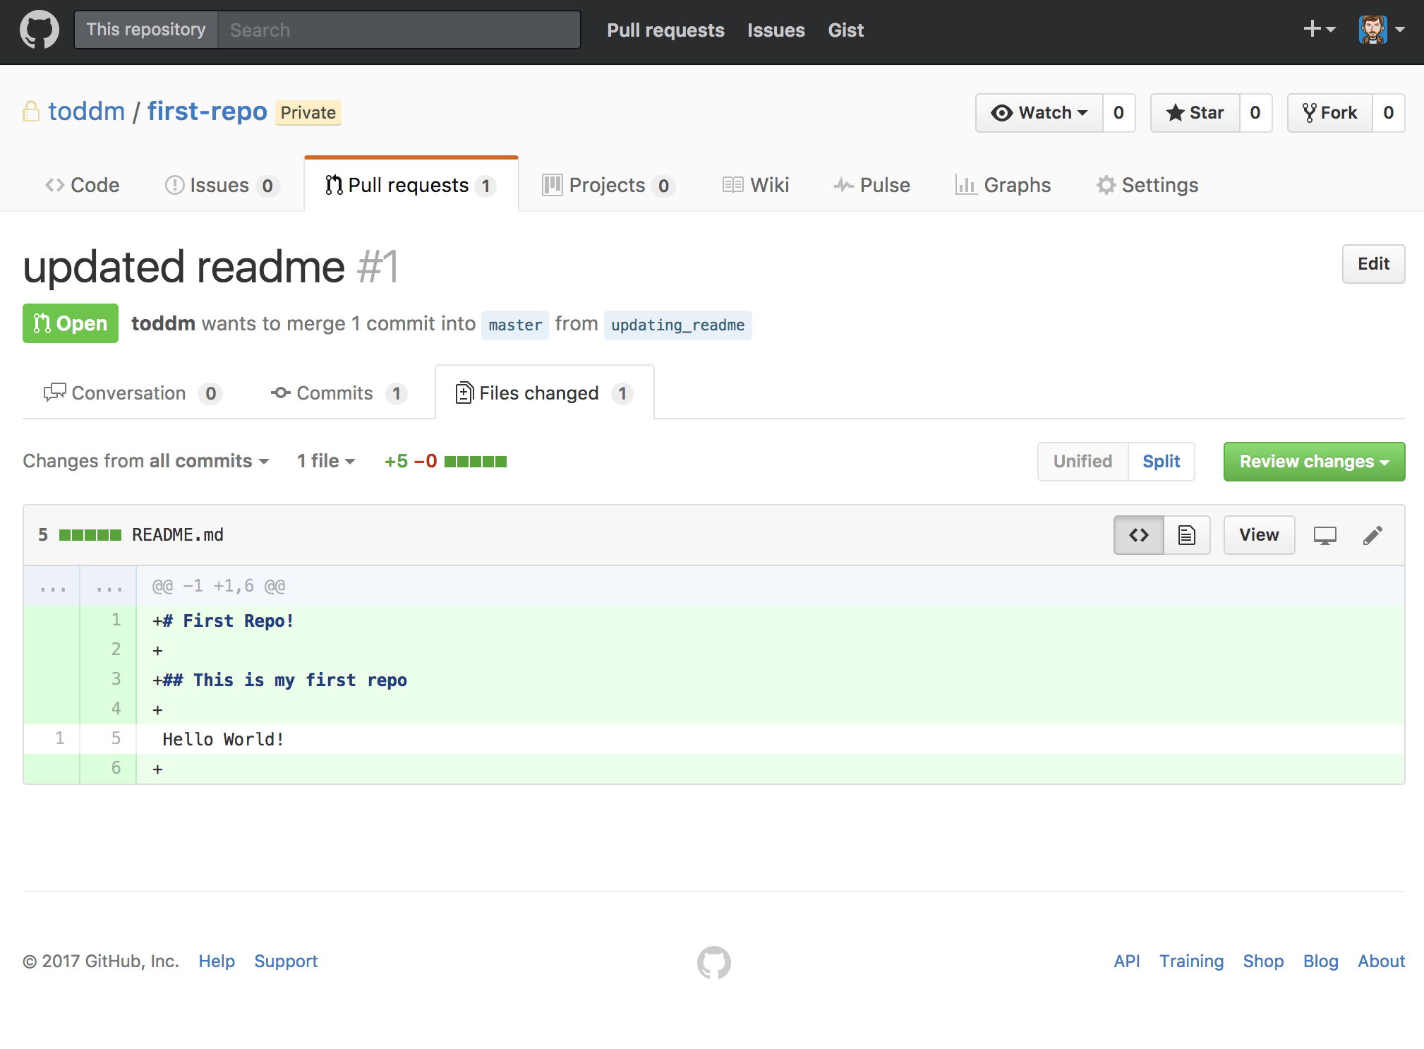
The Pull Request

Slide 43
Performing a Code Review
Code Reviews

Slide 44
Why Request a Code Review
Catch any mistakes early
Learn different ways of doing the same thing
Ensure your code follows established patterns
Find out about existing code that could be reused
Consider using PyLint
Enforces the PEP-8 style guidelines
Built-in to several IDE
Possible configuration required

Slide 45
Code Review Methods
Grab a colleague to come take a look
Organize a group code review
Request a code review as part of a pull request
Most version control systems have formal code reviewing built in

Slide 46
Code Reviews Best Practices
Why?
Second set of eyes
Knowledge transfer
Who?
Someone removed from the effort but familiar with the code
When?
Before merging
What to look for?
Bugs
Duplication
Bad names
Missing tests/documentation

Slide 47
Python Advanced Topics

Slide 48
Error Handling in Python
Python Advanced Topics

Slide 49
Error Handling in Python
Validations (proactive)
Check inputs for valid values
Check for the existence of files before attempting to write
Response codes from shell scripts/API calls
Exceptions (reactionary)
Something unexpected happens during runtime
Can’t write to file
Connection failed
Module doesn’t exist
Division by zero

Slide 50
Error Handling in Python
Handle error states “gracefully”
Try to recover
Examples:
Reconnect?
Create the containing directory and try again?
Log what happened
Exit with appropriate error code if necessary

Slide 51
Exceptions
What are exceptions?
An exception is a built-in way to handle erroneous situations
As the name implies that the problem (the exception) doesn't occur frequently, i.e. the exception is the "exception to the rule".
When an exception occurs:
Execution on that thread halts
If not handled, thread dies
If that thread is the main thread, process exits with an error code
Can be caught and handled programmatically

Slide 52
Python Errors
Some common Python Exceptions:
IOError
If the file cannot be opened
ImportError
If python cannot find the module
ValueError
Raised when a built-in operation or function receives an argument that has the right type but an inappropriate value
NameError
Raised when a local or global name is not found
TypeError
Raised when an operation or function is applied to an object of inappropriate type
KeyboardInterrupt
Raised when the user hits the interrupt key (normally Control-C or Delete)

Slide 53
Handling Exceptions in Python
To handle exception, wrap the risky code in a "try... except... finally" block
try:
risky_code()
print "Did I make it?"
except Exception as e:
print "Something went wrong: %s" % e.message
finally:
print "But always print this."

Slide 54
Group Lab: exception_handling
Look at math_troubles.py
Without running it, what do you think will happen?
Notice what runs and what doesn't and when
Change the print statements to returns, now what happens?
handle_it.py
Let's try some more examples...
Notes:
while True:
try:
num = int(raw_input("please pick a number: "))
except (SyntaxError, NameError):
print "That's not a number"
except (KeyboardInterrupt, EOFError):
print
print "Goodbye"
break
print "you picked %d" % num

Slide 55
Raising Exceptions in Python
The raise statement allows the programmer to force a specified exception to occur.
raise NameError('Not my name!')
If you need to determine whether an exception was raised but don’t intend to handle it, you can re-raise the exception with Raise
try:
raise NameError("Not my name!")
except NameError:
print "Got an exception."
Raise

Slide 56
User-defined Exceptions in Python
You can also create your own exceptions by creating a new class that extends Exception or one of its subclasses
class ServerIsDownException(Exception):
def __init__(self, message):
super(Exception, self).__init__(message)
self.message = message
try:
raise ServerIsDownException("network issues")
except ServerIsDownException as e:
print "Server is down because of {}".format(e.message)

Slide 57
Exception Best Practices
Exception "boil up", handle then when you are able to take action
Handle an exception in a way that benefits the user
Don't handle an exception and do nothing
Bad:
At the least, log what happened
Exceptions are exceptional, don't use them for standard process flow
try:
i = 1 / 0
except Exception:
pass

Slide 58
Logging in Python
Python Advanced Topics

Slide 59
Logging in Python
Why do we create logs?
Metrics on usage
Forensics in case of incidents
Accountability
Provide context

Slide 60
Logging in Python: Example
import logging
logging.basicConfig(level="INFO", format='%(asctime)s - %(levelname)s - %(name)s - %(message)s')
class WidgetMaker():
def __init__(self):
self._logger = logging.getLogger(__name__)
def make_widget(self):
self._logger.debug('this is only for debugging')
self._logger.info('this is informational')
self._logger.warn('this is a warning')
self._logger.error('this is erroneous')
self._logger.fatal('this is fatal')
Output:
2017-10-06 20:58:39,018 - INFO - __main__ - this is informational
2017-10-06 20:58:39,018 - WARNING - __main__ - this is a warning
2017-10-06 20:58:39,018 - ERROR - __main__ - this is erroneous
2017-10-06 20:58:39,018 - CRITICAL - __main__ - this is fatal

Slide 61
Logging in Python: Example
config = { 'disable_existing_loggers': False, 'version': 1, 'formatters': { 'short': { 'format': '%(asctime)s %(levelname)s %(name)s: %(message)s' }, }, 'handlers': { 'console': { 'level': 'INFO', 'formatter': 'short', 'class': 'logging.StreamHandler', }, }, 'loggers': { '': { 'handlers': ['console'], 'level': 'ERROR', }, 'plugins': { 'handlers': ['console'], 'level': 'INFO', 'propagate': False } }, }
import logging.config logging.config.dictConfig(config)

Slide 62
Logging in Python
For further information on Python Logging library:
Python docs:
https://docs.python.org/2/library/logging.html
Tutorial:
https://opensource.com/article/17/9/python-logging

Slide 63
Logging Best Practices
Log on state changes for system
CRUD operations
Authentication events
Scheduled operations
Always include:
Timestamp
Context
File and line number/Module/Class where the event took place
What was desired effect
What went wrong
User involved in action
Username
IP
Lifecycle management
Rotate, archive, destroy

Slide 64
API Calls in Python
Python Advanced Topics

Slide 65
API Calls in Python
What are APIs?
HTTP(S) endpoints
REST
Use HTTP "verbs" to access resources based on URL
GET – fetch data
POST – create data
PUT/PATCH – mutate data
DELETE – delete data
GET/DELETE – data passed via query parameters
POST/PUT/PATCH – data passed via data in the body of the payload
URLs describe resource being accessed
GET https://gateway.marvel.com/v1/public/characters?nameStartsWith=iron - all characters
GET https://gateway.marvel.com/v1/public/characters/1009368 - Iron Man character info

Slide 66
API Calls in Python: GET Example
import urllib2
import json
url = "http://server.lvh.me:4567/users"
request = urllib2.Request(url)
try:
response = urllib2.urlopen(request)
response_data = json.loads(response.read())
print "message %s" % str(response_data['users'])
except urllib2.HTTPError as error:
print "Error: %s - %s" % (error.code, error.reason)

Slide 67
API Calls in Python: POST Example
import urllib
import urllib2
import json
url = 'http://server.lvh.me:4567/users'
auth_token = 'c775bcfe-8a33-4b28-925f-7717527c5ffa'
headers = {'Authorization': auth_token}
payload = {
'name': 'Michael Foord',
'location': 'Northampton',
'language': 'Python'
}
encode_payload = urllib.urlencode(payload)
request = urllib2.Request(url, encode_payload, headers)
try:
response = urllib2.urlopen(request)
response_data = json.loads(response.read())
print "message: %s" % response_data['message']
except urllib2.HTTPError as error:
print "Error: %s - %s" % (error.code, error.reason)

Slide 68
Data Structure Parsing
Python Advanced Topics

Slide 69
JSON Parsing
Format of JSON
key/value
Key is a string
Value is either string, number, object, or array
[
{ "id":1009368, "name":"Iron Man", "description":"Wounded, captured and forced to build a weapon by his enemies, billionaire industrialist Tony Stark instead created an advanced suit of armor to save his life and escape captivity...", "modified":"2016-09-28T12:08:19-0400", "thumbnail":{ "path":"http://i.annihil.us/u/prod/marvel/i/mg/9/c0/527bb7b37ff55", "extension":"jpg" }, "resourceURI":"http://gateway.marvel.com/v1/public/characters/1009368" },
{
...
}
]

Slide 70
JSON Parsing
import json
with open('iron_man.json') as data_file:
parsed_data = json.load(data_file)
for character in parsed_data:
char_id = str(character['id'])
name = character['name']
thumbnail = "%s.%s" % (character['thumbnail']['path'], character['thumbnail']['extension'])
print "ID: %s" % char_id
print "Name: %s" % name
print "Image: %s" % thumbnail
print
ID: 1009368
Name: Iron Man
Image: http://i.annihil.us/u/prod/marvel/i/mg/9/c0/527bb7b37ff55.jpg
ID: 1011318
Name: Iron Fist (Bei Bang-Wen)
Image: http://i.annihil.us/u/prod/marvel/i/mg/9/20/53176ebd40ad7.jpg

Slide 71
Coding Principles

Slide 72
Single Responsibility PRINCIPLE
Coding Principles

Slide 73
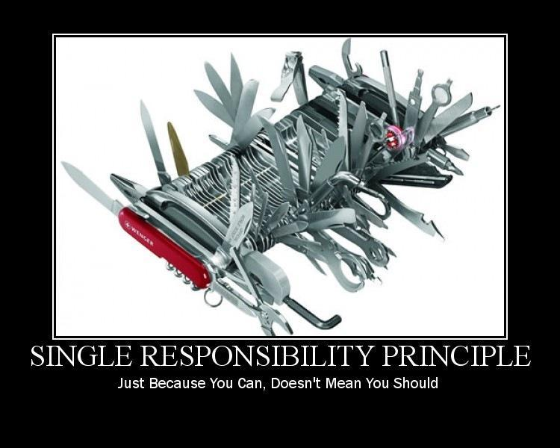
Single Responsibility Principle

Slide 74
Single Responsibility Principle
Every module has exactly one job. It does:
All of that job
Only that job
Its job well
‘Responsibility’ is defined as a reason to change.
Benefits: makes the class more robust and prevents ‘side effect errors’.
Rule of Thumb:
Can you state responsibility of module in 25 words or fewer, without saying and or or?

Slide 75
Lab: single_responsibility_principle
What's going on?
What's code is responsible for what behavior?
What happens when we need to make a change?

Slide 76
Object-Oriented Design: Abstraction/Encapsulation
Capture all the related functionality into a single class/object
Hide the internal workings of an object
Don’t expose the data fields
Only interaction is through method calls
Notes:
https://stackoverflow.com/questions/21220155/what-does-abstraction-mean-in-programming#answer-21220945

Slide 77
Testing With External Systems
Coding Principles

Slide 78
Testing Techniques
Abstraction/Encapsulation
Work with objects that we know how to use without knowing how it works
Dependency Inversion
Mocking

Slide 79
Dependency Inversion Principle
When one class uses another
Reporting explicitly knows about this EmployeeDAO.
Any time Reporting is used, EmployeeDAO has to be brought along as well.
As well as any classes EmployeeDAO uses
And the classes those classes use
And so on.
Reporting
EmployeeDAO

Slide 80
Dependency Inversion Principle
Prefer to depend on
abstractions
Client knows about AbstractDAO
This is an abstraction of family of DAOs
AbstractDAO has no dependencies
Reporting is less tightly coupled with EmployeeDAO
AbstractDAO
Reporting
EmployeeDAO
Notes:
Decouples high-level components from lower-level components.
Example: If your car needs a new battery.
Car only ‘abstractly’ depends on battery, instead of directly replacing a specific brand of battery, it depends on an abstraction. As long as that abstraction conforms to the car’s design (contract/interface), it can be used.

Slide 81
Abstraction/Encapsulation
Example:
Usage:
import MySQLdb
class EmployeeDao():
def get_employees(self):
db = MySQLdb.connect(user='root',
host='127.0.0.1', db='py_employees')
cursor = db.cursor()
cursor.execute("SELECT id, first, last FROM employees")
results = []
row = cursor.fetchone()
while row is not None:
results += [row]
row = cursor.fetchone()
db.close()
return results
import EmployeesDAO
employees = EmployeesDAO().get_all_employees()

Slide 82
Dependency Inversion Principle
import EmployeeDao
class ReportGenerator:
def print_employee_names(self):
dao = EmployeeDao()
try:
employees = dao.get_employees()
self._output.print_line('ID - Last, First')
for employee in employees:
line = "{0} - {2}, {1}".format(employee[0],
employee[1], employee[2])
self._output.print_line(line)
except Exception:
self._output.print_line("An error occurred...")
Any time ReportGenerator is used, a connection to the database is created
How does that affect our ability to test?
Are our tests repeatable?
How long is our feedback cycle for changes?

Slide 83
Dependency Inversion Principle
class ReportGenerator:
def __init__(self, dao, output):
self._dao = dao
self._output = output
def print_employee_names(self):
try:
employees = self._dao.get_employees()
self._output.print_line('ID - Last, First')
for employee in employees:
line = "{0} - {2}, {1}".format(employee[0],
employee[1], employee[2])
self._output.print_line(line)
except Exception:
self._output.print_line("An error occurred...")
Notice we use a generic dao object that is given to the ReportGenerator class
Do we need a database connection?
What's setup is needed to run our tests?

Slide 84
LAB: Dependency Inversion Principle
Run the example
Swap out the implementation for the employee provider
Can you image how to write tests around this?

Slide 85
LAB: Dependency Inversion Principle with Tests
So how does DI help with testing?
Use test doubles to write tests that use databases without having a database

Slide 86
Mock objects: Advantages over real objects
Why mock? Isn't it better to test with the actual classes?
Real object is difficult to set up
Real object is slow
Real object has behavior that is hard to recreate
e.g., loss of connection, network down
Real object can have non-deterministic behavior
impossible to assert against
Real object may depend on user interaction
Real object may not exist yet

Slide 87
Mocking Frameworks
Writing stubs is a lot of extra code
Mocking frameworks take the place of manual stubbing
Can mock-out system calls
Less code, less clear
Use with caution
Python libraries:
Mock, MagicMock
pytest-mock (mocker)

Slide 88
Lab: mocking
See the usage of mocking
Notice no actual system calls are being made

Slide 89
Extended Lab

